Slide 1
Introduction to Deep Learning

Slide 2
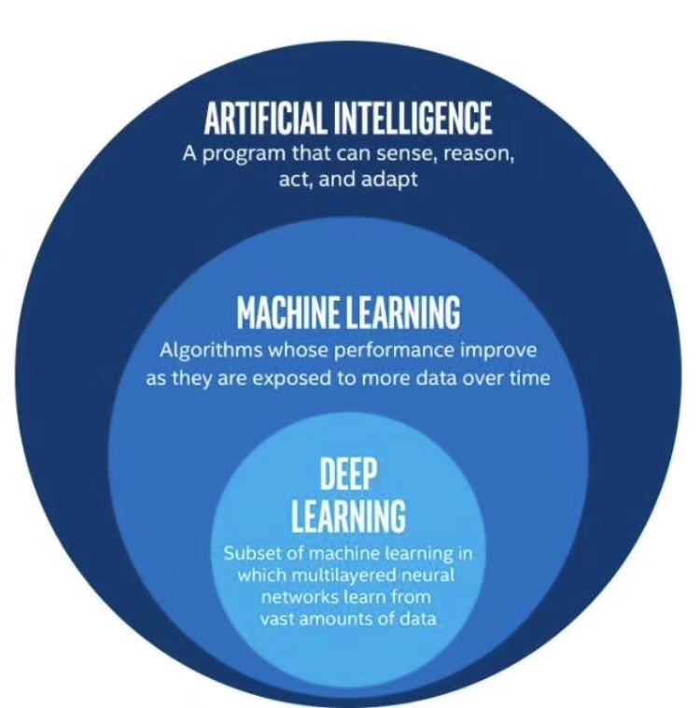
分类

Slide 3
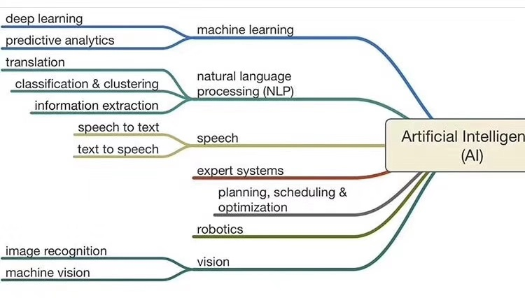

Slide 4
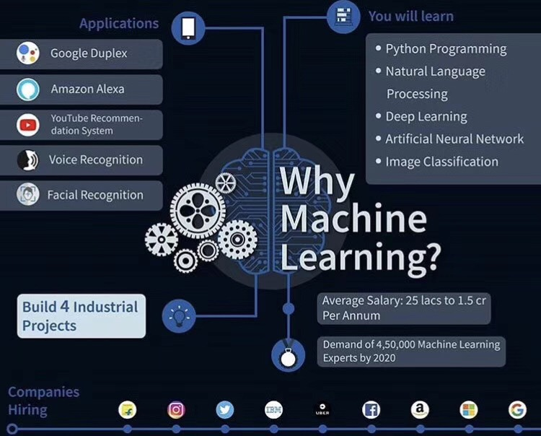

Slide 5
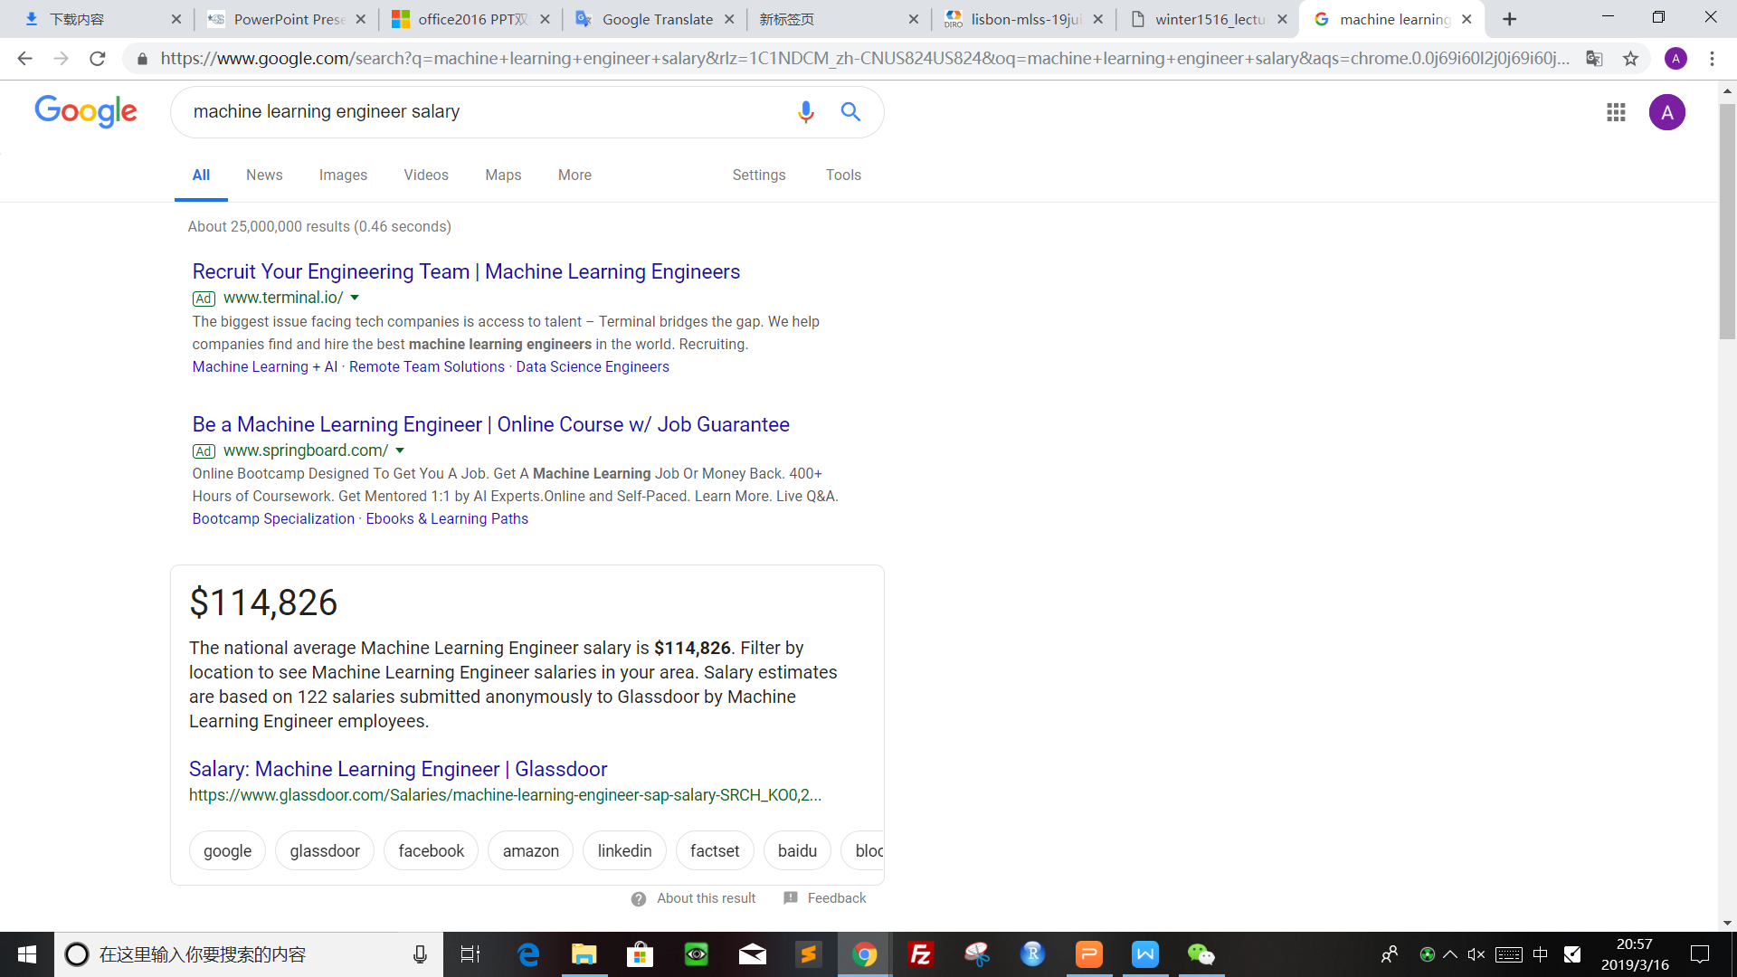

Slide 6
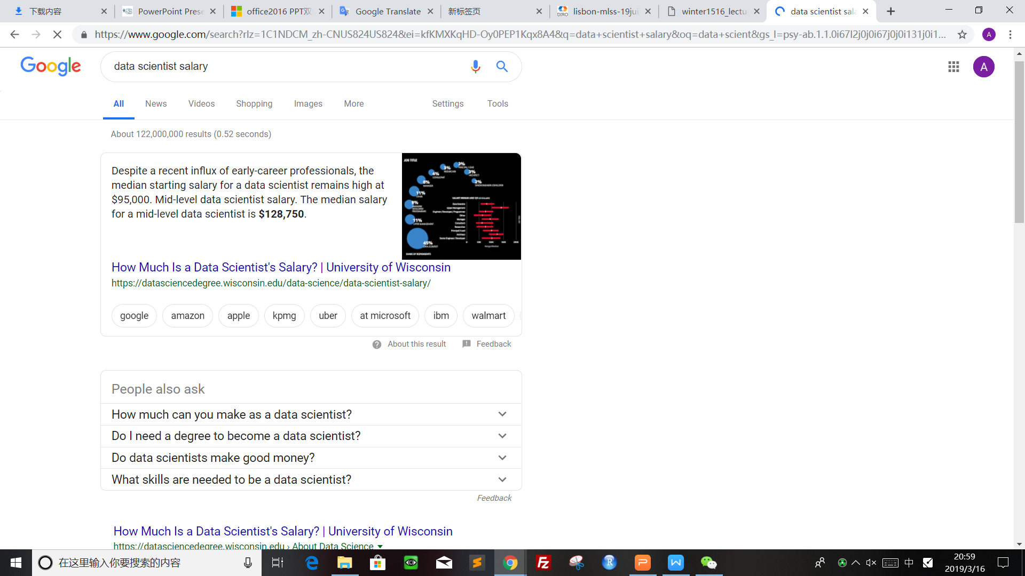

Slide 7
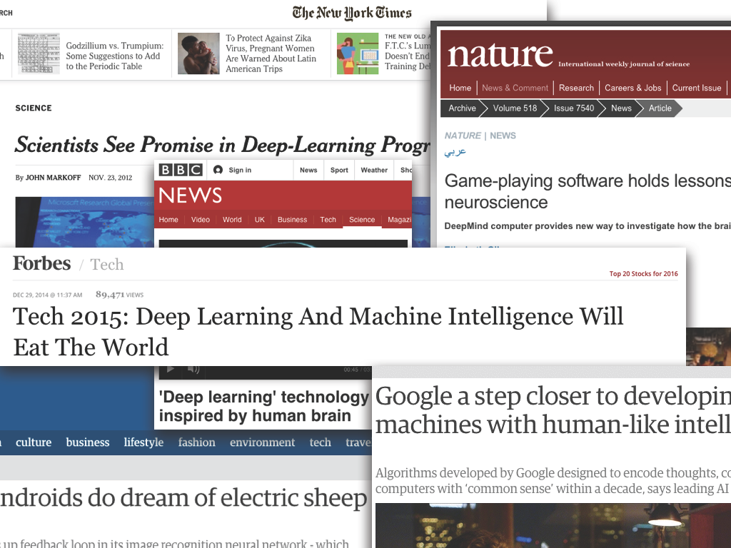
Deep Learning: Hype or Hope?

Slide 8
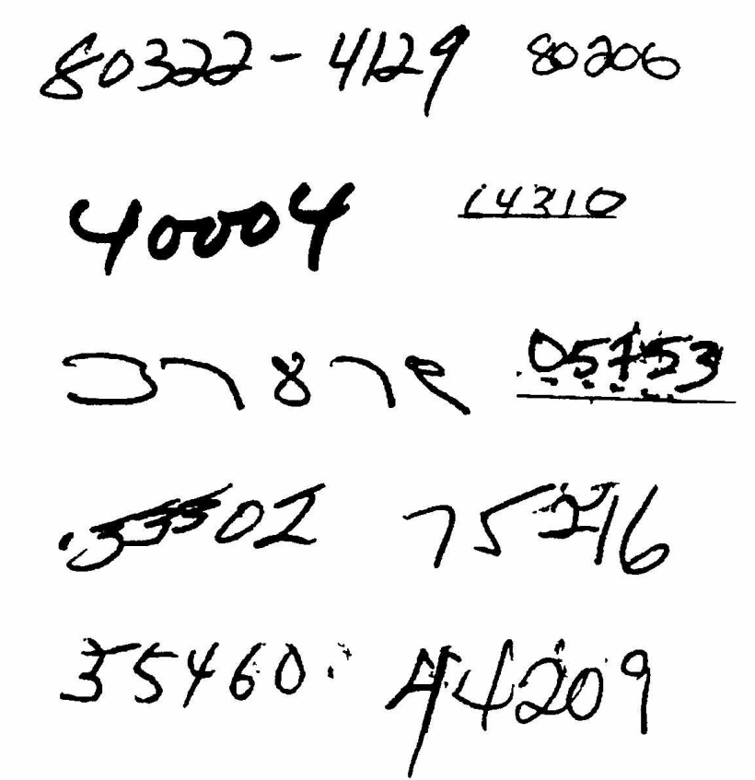
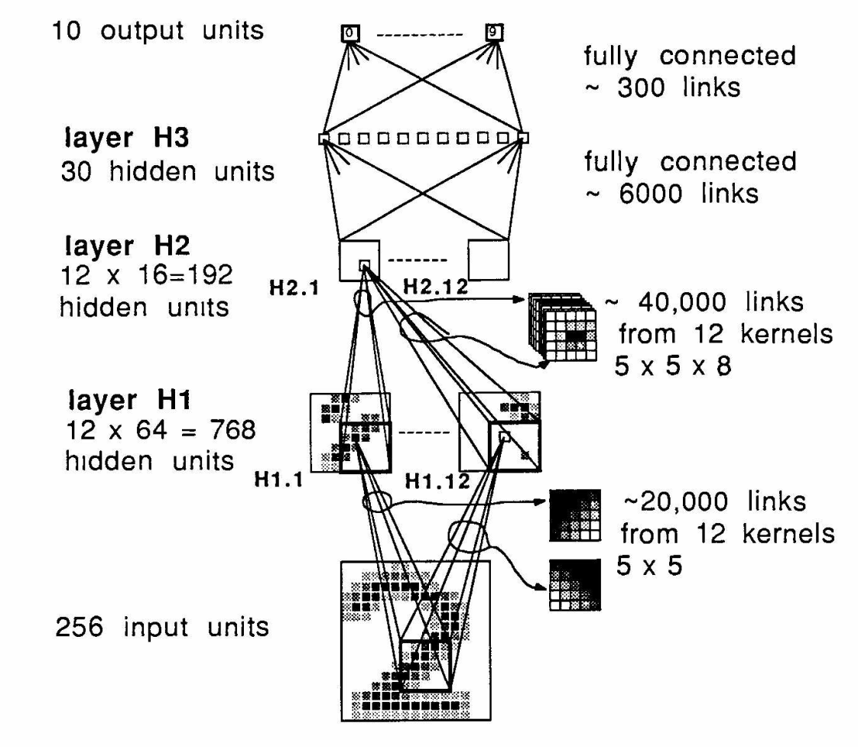
Milestones: Digit Recognition
LeNet 1989: recognize zip codes, Yann Lecun, Bernhard Boser and others, ran live in US postal service
Notes:
Around 5% error rate. Good enough to be useful.

Slide 9
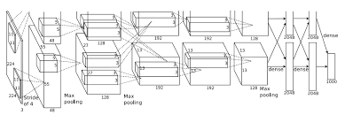
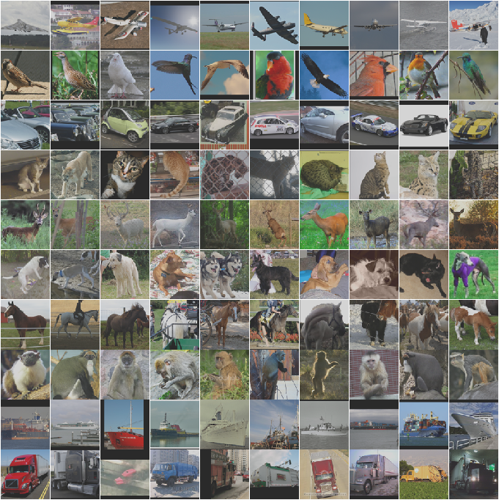
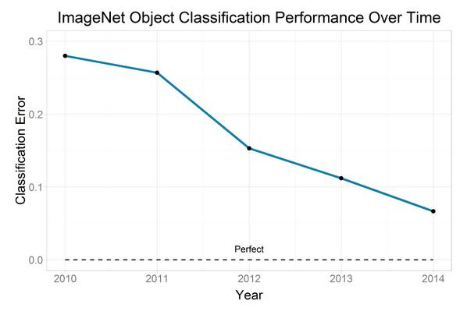
Milestones: Image Classification
Convolutional NNs: AlexNet (2012): trained on 200 GB of ImageNet Data
Human performance 5.1% error

Slide 10
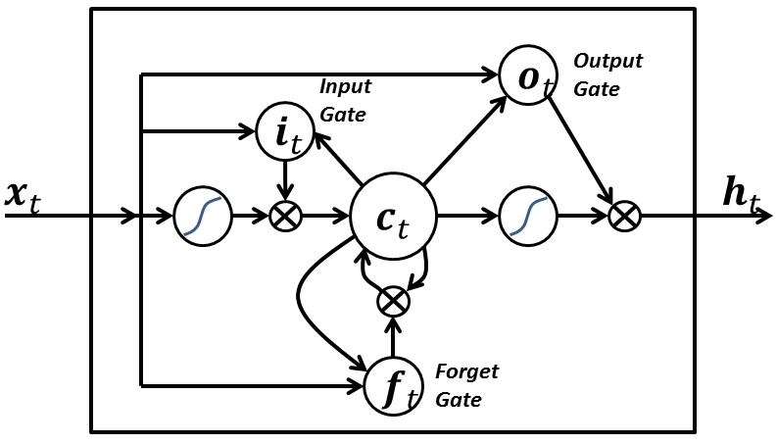
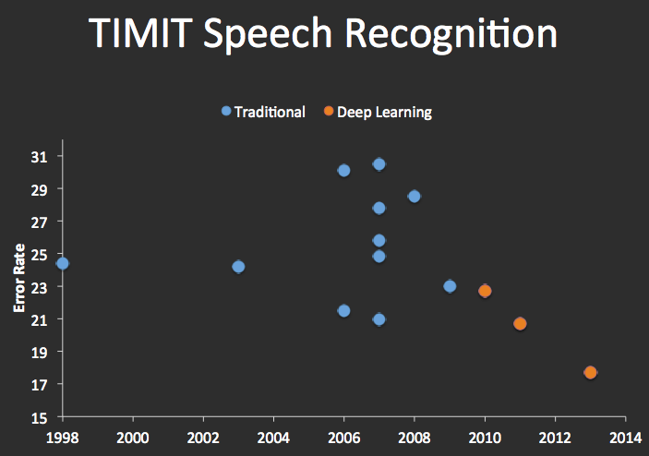
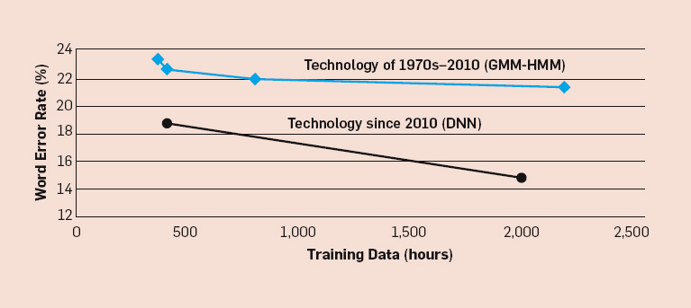
Milestones: Speech Recognition
Recurrent Nets: LSTMs (1997):

Slide 11
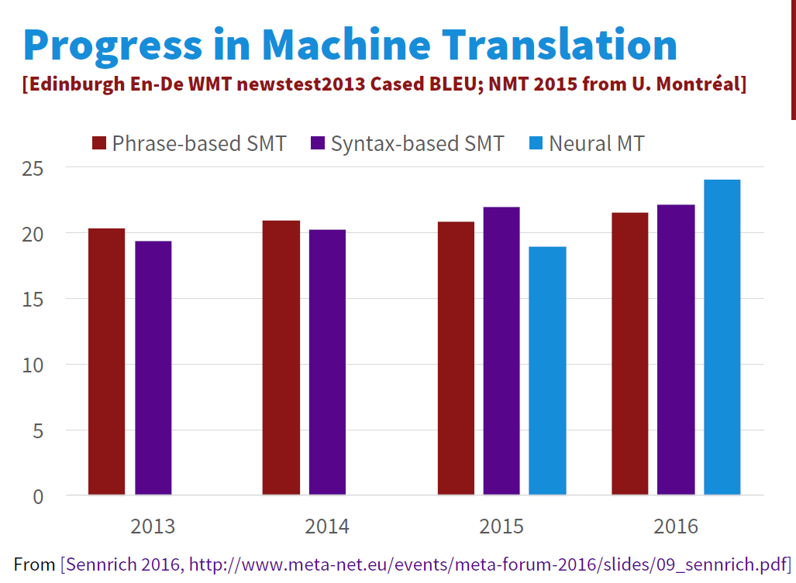
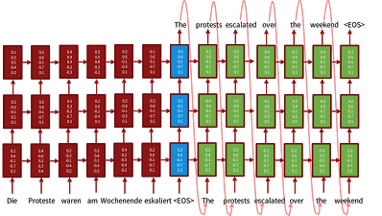
Milestones: Language Translation
Sequence-to-sequence models with LSTMs and attention:

Slide 12
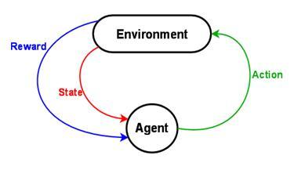
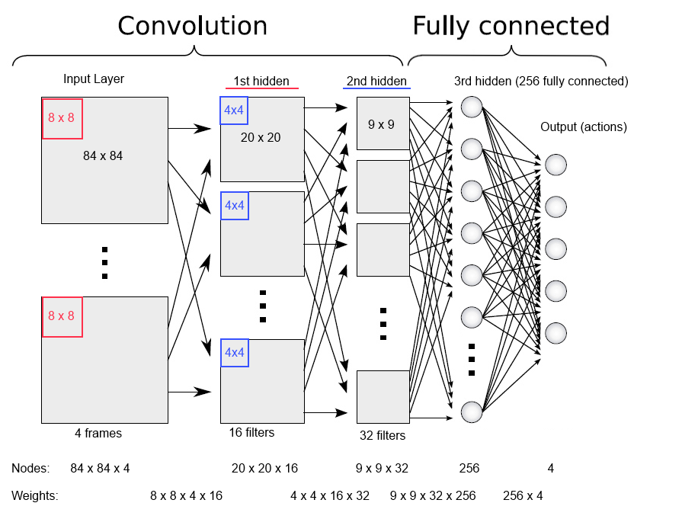
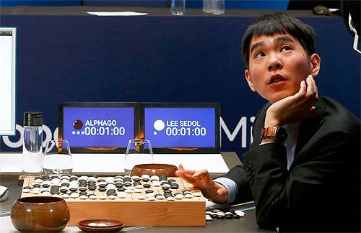
Milestones: Deep Reinforcement Learning
In 2013, Deep Mind’s arcade player bests human expert on six Atari Games. Acquired by Google in 2014.
In 2016, Deep Mind’s
alphaGo defeats former world champion Lee Sedol
Notes:
Founders: Demis Hassabis, Shane Legg, Mustafa Suleyman
Why was this milestone particularly worrying from an ethics point of view?

Slide 13
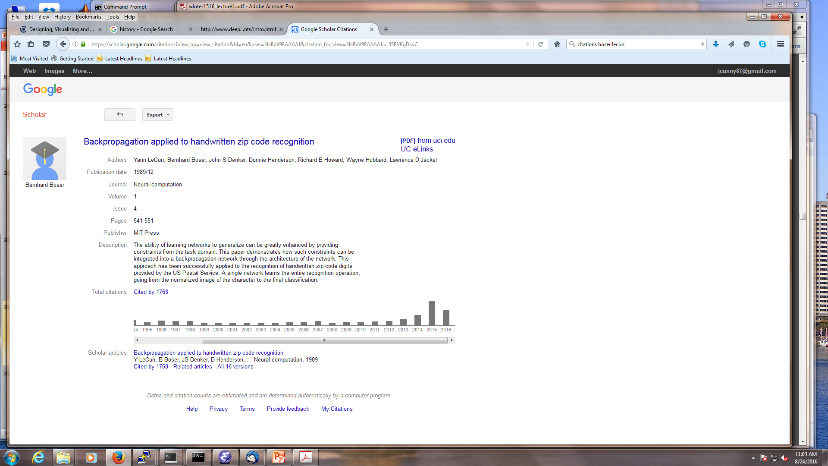

Citations of the “LeNet” paper
回想一下，LeNet是一个现代的视觉分类网络，可识别邮政编码的数字。 它的引用如下：
2000年代是机器学习的黄金时代，标志着图形模型的上升。 但神经网络并非如此。
Second phase
Deep Learning “Winter”
Third phase

Slide 14
Outline
Introduction
Supervised Learning
Convolutional Neural Network
Sequence Modelling: RNN and its extensions
Unsupervised Learning
Autoencoder
Stacked Denoising Autoencoder
Reinforcement Learning
Deep Reinforcement Learning
Two applications: Playing Atari & AlphaGo & Alpha Star
& Alpha floder

Slide 15
Types of Learning
Supervised (inductive) learning
Training data includes desired outputs
Unsupervised learning
Training data does not include desired outputs
Semi-supervised learning
Training data includes a few desired outputs
Reinforcement learning
Rewards from sequence of actions

Slide 16
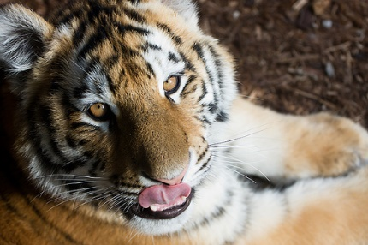
Introduction
传统的模式识别模型使用手工制作的功能和相对简单的训练分类。
这种方法有以下局限：
开发手工制作的功能非常繁琐且成本高昂
手工制作的功能通常在一个应用程序中具有高度依赖性，并且无法轻松转移到其他应用程序
hand-crafted feature extractor
“Simple” Trainable Classifier
output

Slide 17

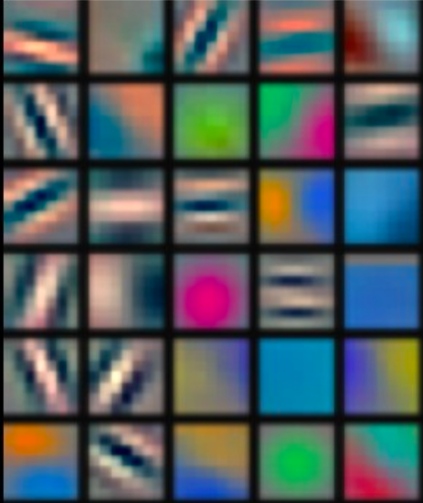
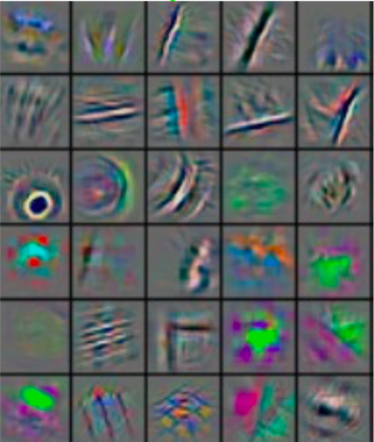
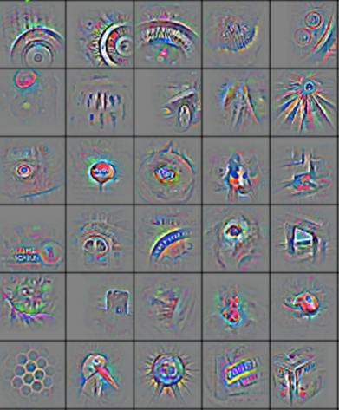
Deep Learning
深度学习（a.k.a.表示学习）旨在通过特征学习过程的多个阶段自动学习丰富的层次表示（即特征）。
Low-level features
Mid-level features
High-level features
Trainable classifier
output
Feature visualization of convolutional net trained on ImageNet
(Zeiler and Fergus, 2013)

Slide 18
学习分层表示
Low-level features
Mid-level features
High-level features
Trainable classifier
output
Increasing level of abstraction
抽象级别越来越高的表示层次结构。 每个阶段都是一种可训练的非线性特征变换
Image recognition
Pixel → edge → texton → motif → part → object
Text
Character → word → word group → clause → sentence → story
Notes:
The word ‘deep’ in deep learning refers to the layered model architectures which are usually deeper than conventional learning models.

Slide 19
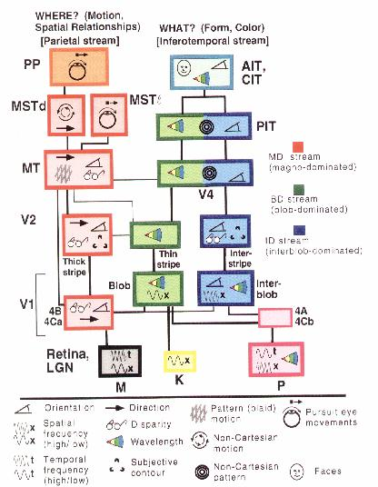
哺乳动物视觉皮层是分层的
受大自然启发很好，但不是太多。
我们需要了解哪些细节很重要，哪些细节仅仅是进化的结果。
深度学习中的每个模块都以类似于人类皮层的方式将其输入表示转换为更高级别的输入表示。
(van Essen and Gallant, 1994)

Slide 20
Supervised Learning
Convolutional Neural Network
Sequence Modelling
Why do we need RNN?
What are RNNs?
RNN Extensions
What can RNNs can do?

Slide 21
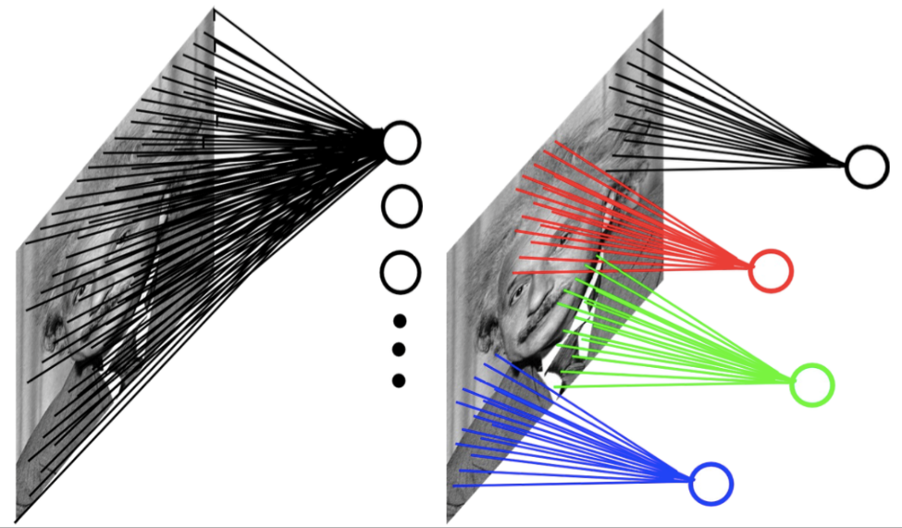
Convolutional Neural Network
输入可以具有非常高的尺寸。 使用完全连接的神经网络需要大量参数。
受[Hubel＆Wiesel 1962]进行的神经生理学实验的启发，CNN是一种特殊类型的神经网络，其隐藏单元仅与局部感受野相连。 CNN所需的参数数量要小得多。
Example: 200x200 image
fully connected: 40,000 hidden units => 1.6 billion parameters
CNN: 5x5 kernel, 100 feature maps => 2,500 parameters

Slide 22
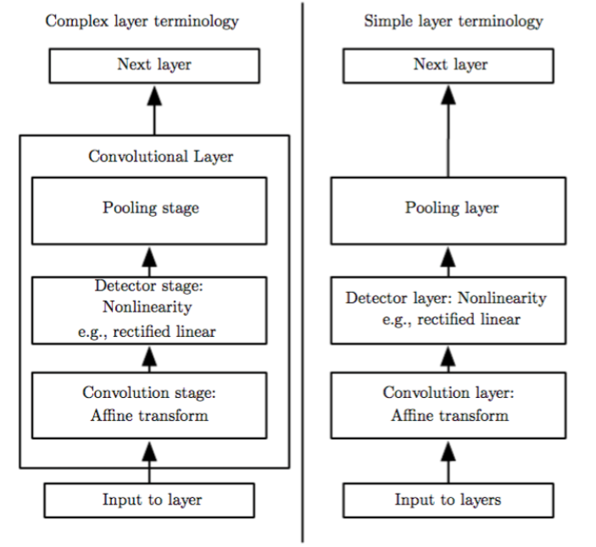
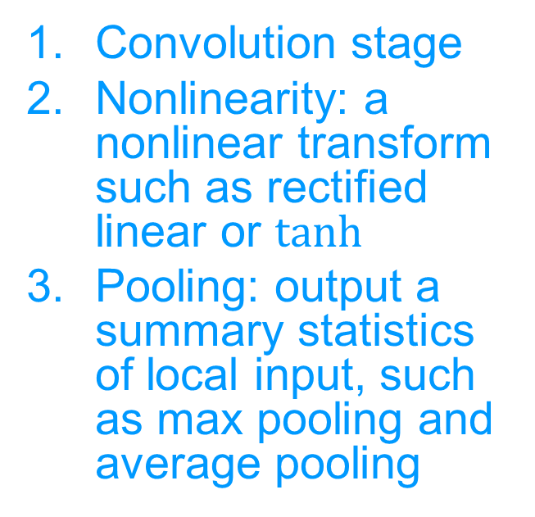
卷积层的三个阶段
Convolution stage
Nonlinearity: a nonlinear transform such as rectified linear or $tanh$
Pooling: output a summary statistics of local input, such as max pooling and average pooling

Slide 23
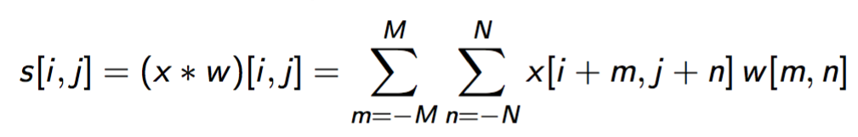
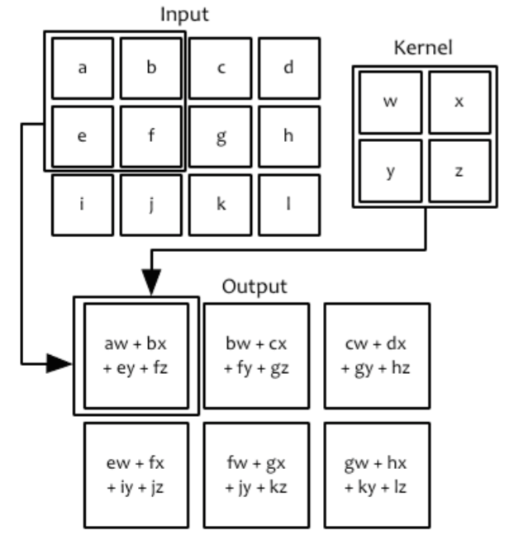
CNN中的卷积运算
输入：图像（2-D数组）x
卷积核/运算符（可学习参数的二维数组）：w
要素图（已处理数据的二维数组）：s
二维域中的卷积运算：

Slide 24
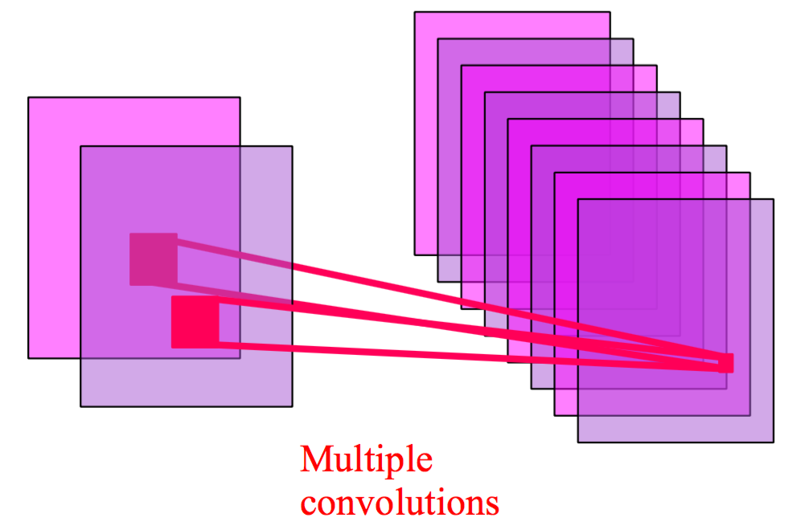
多个卷积
通常有多个特征映射，每个卷积运算符一个。

Slide 25
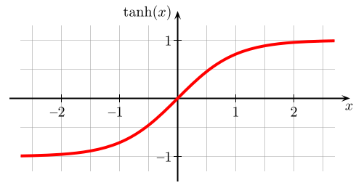
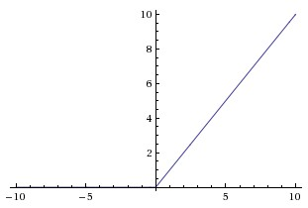
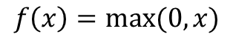
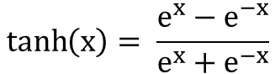
非线性
Tanh(x)
ReLU
$$\tanh\left(x\right)= \frac{e^{x}−e^{−x}}{e^{x}+e^{−x}}$$
$$f\left(x\right)=max⁡(0, x)$$

Slide 26
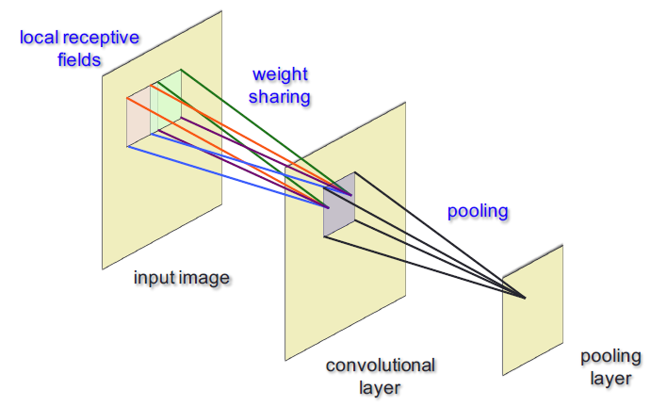
池化
常见的池化操作：
最大池: 报告矩形邻域内的最大输出.
平均池化: 报告矩形邻域的平均输出（可能通过距中心像素的距离加权）。
Notes:
By spacing pooling regions k > 1 (rather than 1) pixels apart, the next higher layer has roughly k times fewer inputs to process, leading to downsampling.

Slide 27
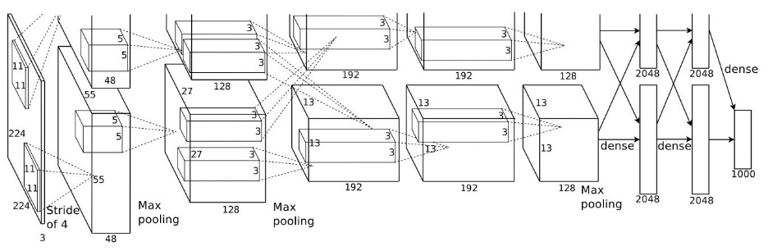
Deep CNN：ImageNet 2012的获胜者
(Alex et al., 2012)
每个卷积层的多个特征映射。
多个卷积层，用于提取不同级别的要素。较高级别的图层将较低级别图层中的要素图作为输入。

Slide 28
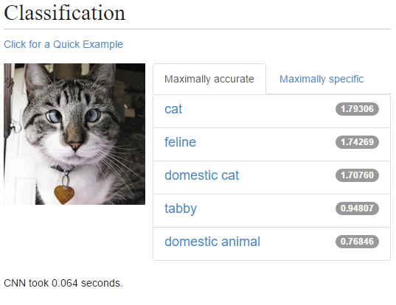
Deep CNN for Image Classification
Try out a live demo at http://demo.caffe.berkeleyvision.org/

Slide 29
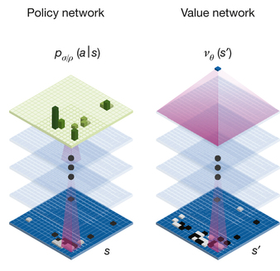
Deep CNN in AlphaGO
策略网络 :
Input: 19x19, 48 input channels
Layer 1: 5x5 kernel, 192 filters
Layer 2 to 12: 3x3 kernel, 192 filters
Layer 13: 1x1 kernel, 1 filter
价值网络具有与策略网络类似的架构
(Silver et al, 2016)

Slide 30
Sequence Modelling
Why do we need RNN?
What are RNNs?
RNN Extensions
What can RNNs can do?

Slide 31
Why do we need RNNs?
神经网络（CNN）的局限性
依靠（训练和测试）例子中的独立性假设。
在每个数据点进行处理之后整个网络状态都丢失了
依靠固定长度的矢量示例
我们需要使用时间或顺序结构以及不同长度的输入和输出对数据建模

Slide 32
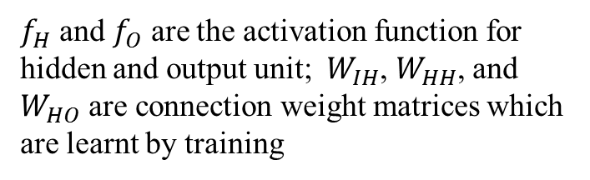
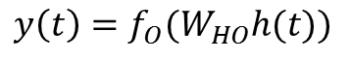
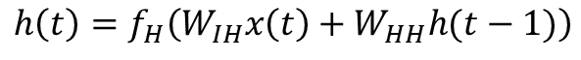
What are RNNs?
循环神经网络（RNN）是连接模型，能够选择性地跨序列步骤传递信息，同时一次处理一个元素的顺序数据。
允许先前输入的“存储器”保持在网络的内部状态，从而影响网络输出
$$h\left(t\right)=f_{H}\left(W_{IH}x\left(t\right)+W_{HH}h(t−1)\right)$$
$$y\left(t\right)=f_{O}(W_{HO}h(t))$$
$f_{H}$ and $f_{O}$ are the activation function for hidden and output unit;$W_{IH}$, $W_{HH}$, and $W_{HO}$ are connection weight matrices which are learnt by training
最简单形式的完全递归神经网络是一个MLP，其中前一组隐藏单元激活与输入一起反馈到网络中

Slide 33
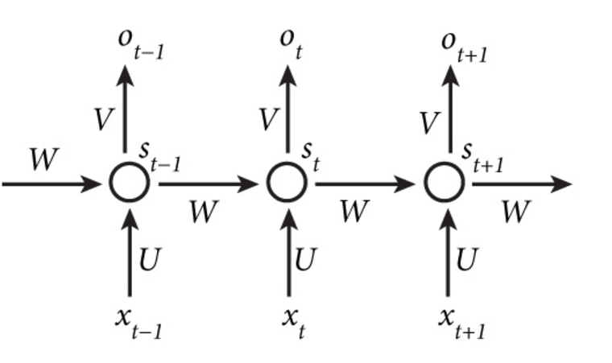
What are RNNs?
通过随时间展开，可以将循环网络转换为前馈网络
一个展开的经常性网络。 每个节点在单个时间步骤表示一层网络单元。 从输入层到隐藏层的加权连接标记为'w1'，从隐藏层到自身的加权连接（即重复权重）标记为'w2'，隐藏输出权重标记为'w3'。 请注意，每个时间步都重复使用相同的权重。 为清楚起见，省略了偏差权重。

Slide 34

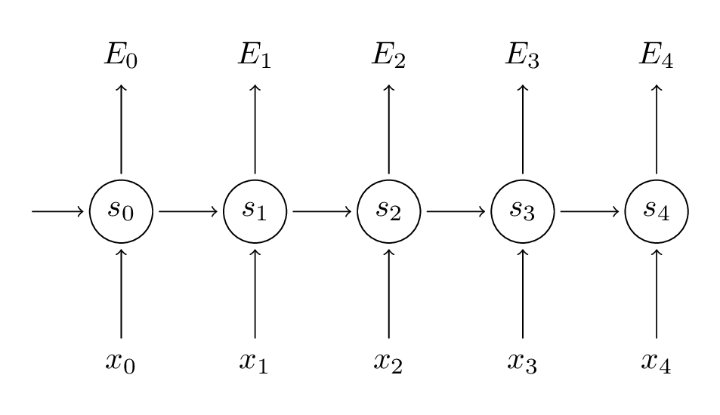
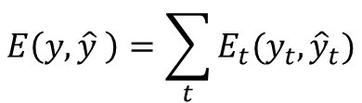
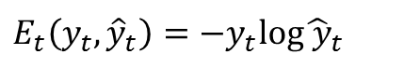
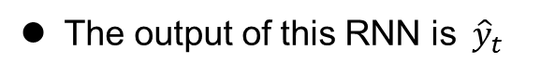
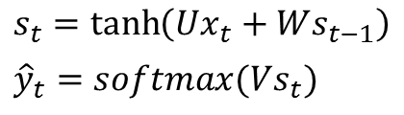
What are RNNs?
Training RNNs (determine the parameters)
通过时间反向传播（BPTT）通常用于学习RNN
BPTT是反向传播（BP）的扩展
The output of this RNN is${ \hat{y}}_{t}$
$$s_{t}=\tanh\left(Ux_{t}+Ws_{t−1}\right)$$
$${\hat{y}}_{t}=softmax(Vs_{t})$$
The loss/error function of this network is
The error at each time step
$$E_{t}\left(y_{t},{\hat{y}}_{t}\right)=−y_{t}log{\hat{ y}}_{t}$$
$$E\left(y,\hat{y} \right)=\sum_{t}{E_{t}(y_{t},{\hat{y}}_{t})}$$
the total loss is the sum of the errors at each time step

Slide 35
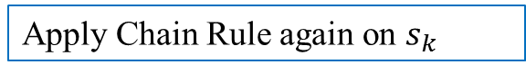
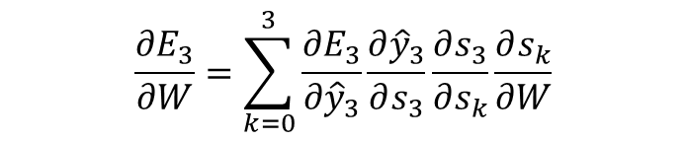





What are RNNs?
Training RNNs (determine the parameters)
The gradients of the error with respect to our parameters
Just like we sum up the errors, we also sum up the gradients at each
time step for one training example. For parameter $W$, the gradient is
$$\frac{∂E}{∂W}=\sum_{t}{\frac{∂E_{t}}{∂W}}$$
The gradient at each time step
we use time 3 as an example
$$\frac{∂E_{3}}{∂W}=\frac{∂E_{3}}{∂{\hat{y}}_{3}}\frac{∂{\hat{y}}_{3}}{∂s_{3}}\frac{∂s_{3}}{∂W}$$
Chain Rule
$$s_{3}=tanh⁡(Ux_{1}+Ws_{2})$$
$s_{3}$depends on $W$and $s_{1}$, we cannot simply treat $s_{2}$ a constant
$$\frac{∂E_{3}}{∂W}=\sum_{k=0}^{3}{\frac{∂E_{3}}{∂{\hat{y}}_{3}}\frac{∂{\hat{y}}_{3}}{∂s_{3}}\frac{∂s_{3}}{∂s_{k}}\frac{∂s_{k}}{∂W}}$$
Apply Chain Rule again on $s_{k}$

Slide 36


What are RNNs?
训练RNN（确定参数）
$$\frac{∂E_{3}}{∂W}=\sum_{k=0}^{3}{\frac{∂E_{3}}{∂{\hat{y}}_{3}}\frac{∂{\hat{y}}_{3}}{∂s_{3}}\frac{∂s_{3}}{∂s_{k}}\frac{∂s_{k}}{∂W}}$$
Becaise $W$ is used in every step up to the output we care about, we need to back-propagate gradients from $t=3$ through the network all the way to $t=0$

Slide 37


What are RNNs?
消失的梯度问题
为了理解原因，让我们仔细看看上面计算的渐变：
$$\frac{∂E_{3}}{∂W}=\sum_{k=0}^{3}{\frac{∂E_{3}}{∂{\hat{y}}_{3}}\frac{∂{\hat{y}}_{3}}{∂s_{3}}\frac{∂s_{3}}{∂s_{k}}\frac{∂s_{k}}{∂W}}$$
$$\frac{∂E_{3}}{∂W}=\sum_{k=0}^{3}{\frac{∂E_{3}}{∂{\hat{y}}_{3}}\frac{∂{\hat{y}}_{3}}{∂s_{3}}\prod_{j=k+1}^{3}{\frac{∂s_{j}}{∂s_{j−1}}}\frac{∂s_{k}}{∂W}}$$
因为深度神经网络的层和时间步长通过乘法相互关联，所以导数很容易消失
来自“遥远”步骤的渐变贡献变为零，并且这些步骤的状态对您正在学习的内容没有贡献：您最终不会学习远程依赖。

Slide 38

What are RNNs?
Proper initialization of the matrix can reduce the effect of vanishing gradient
如何消除消失的梯度问题？
Proper initialization of the $W$ matrix can reduce the effect of vanishing gradients
Use ReLU instead of tanh or sigmoid activation function
ReLU derivate is a constant of either 0 or 1, so it isn’t likely to suffer
from vanishing gradients
Use Long Short-Term Memory or Gated Recurrent unit architectures
LSTM will be introduced later

Slide 39




RNN扩展：双向递归神经网络
传统的RNN只模拟当前状态对先前状态的依赖性，BRNNs（Schuster和Paliwal，1997）扩展到模型对过去状态和未来状态的依赖。
例如：预测要查看左侧和右侧上下文的序列中的缺失单词。
$${\vec{h}}_{t}=f(W_{x\vec{h}}x_{t}+W_{\vec{h}\vec{h}}{\vec{h}}_{t−1}+b_{\vec{h}})$$
训练序列向前和向后到两个独立的复现隐藏层
$${\overset{⃐}{h}}_{t}=f(W_{x\overset{⃐}{h}}x_{t}+W_{\overset{⃐}{h}\overset{⃐}{h}}{\overset{⃐}{h}}_{t−1}+b_{\overset{⃐}{h}})$$
$$y_{t}=W_{\vec{h}y}{\vec{h}}_{t}+W_{\overset{⃐}{h}y}{\overset{⃐}{h}}_{t}+b_{y}$$
过去和未来的背景决定了产出
An unfolded BRNN

Slide 40

RNN Extensions: Long Short-term Memory
消失的梯度问题阻止了标准RNN学习长期依赖性。 LSTMs（Hochreiter和Schmidhuber，1997）旨在通过门控机制来对抗消失的梯度。
LSTM的门控机制，通过粘贴隐藏状态和电流输入产生当前隐藏状态。它包含五个模块：输入门，新存储器单元，遗忘门，最终存储器生成和输出门。

Slide 41


RNN Extensions: Long Short-term Memory
LSTM的门控机制
New memory cell
$${\tilde{c}}_{t}=\tanh{{(W}^{c}x_{t}+U^{c}h_{t−1}) }$$
New memory
使用输入字和过去隐藏状态来生成包含新输入方面的新内存

Slide 42


RNN Extensions: Long Short-term Memory
A gating mechanism of the LSTM
遗忘门
$$f_{t}=σ({W^{f}x_{t}+U^{f}h_{t−1}) }$$
遗忘门查看输入字和过去隐藏状态，并评估过去的存储器单元是否对计算当前存储器单元有用

Slide 43







RNN Extensions: Long Short-term Memory
A gating mechanism of the LSTM
最终记忆细胞
$$i_{t}$$
$$c_{t}=f_{t}∘c_{t−1}+i_{t}∘{\tilde{c}}_{t}$$
$${\tilde{c}}_{t}$$
This stage first takes the advice of the forget gate $f_{t}$ and accordingly forgets the past memory $c_{t−1}.\text{Similarly}\text{, }\text{it} \text{takes}$ the advice of the input gate $i_{t}$ and accordingly gates the new memory. It then sums these two results to produce the final memory
$$c_{t−1}$$
$$f_{t}$$

Slide 44



RNN Extensions: Long Short-term Memory
LSTM的门控机制
输出门
$$o_{t}=σ(W_{o}x_{t}+U_{o}h_{t−1})$$
This gate makes the assessment regarding what parts of the memory $c_{t}$needs to be exposed/present in the hidden state $h_{t}$.

Slide 45


RNN Extensions: Long Short-term Memory
A gating mechanism of the LSTM
隐藏的状态
$$h_{t}=o_{t}∘tanh⁡(c_{t})$$

Slide 46
RNN extensions: Long Short-term memory
Conclusions on LSTM
LSTM包含门控单元中循环网络正常流量之外的信息。 信息可以存储在单元中，写入单元或从单元读取，就像计算机存储器中的数据一样。 单元格通过迭代过程来了解何时允许数据进入，离开或被删除，这些过程是通过猜测，反向传播错误以及通过梯度下降来调整权重。

Slide 47
RNN extensions: Long Short-term Memory
为什么LSTM可以解决消失的梯度问题？
LSTM有助于保留可以通过时间和层反向传播的错误。 通过保持更加恒定的错误，它们允许经常性的网络继续学习多个时间步长（超过1000），从而打开一个通道来远程链接原因和结果

Slide 48
What can RNNs can do?
机器翻译
视觉问题回答

Slide 49

Machine Translation
在机器翻译中，输入是源语言中的单词序列，输出是目标语言中的单词序列。
编码器：将输入句子编码为隐藏状态的RNN（特征）
解码器：一种RNN，其源语言中隐藏的句子状态作为输入并输出翻译的句子
用于机器翻译的编码器 - 解码器架构

Slide 50

Visual Question Answering (VQA)
Demo Website
VQA：给定关于图像的图像和自然语言问题，任务是提供准确的自然语言答案
Picture from (Antol et al., 2015)

Slide 51

Visual Question Answering
输出将以图像和文本输入为条件。 CNN用于对图像进行编码，并且实现RNN以对句子进行编码。

Slide 52
非监督学习
自动编码器
深度自动编码器
去噪自动编码器
堆叠去噪自动编码器

Slide 53


Autoencoders
An Autoencoder is a feedforward neural network that learns to predict the input itself in the output.
$y^{(i)}=x^{(i)}$
The input-to-hidden part corresponds to an encoder
The hidden-to-output part corresponds to a decoder.

Slide 54

Deep Autoencoders
通过扩展具有多个隐藏层的自动编码器的编码器和解码器来构造深度自动编码器。
梯度消失问题：梯度变得太小，因为它通过许多层返回
Diagram from (Hinton and Salakhutdinov, 2006)

Slide 55
Training Deep Autoencoders
Diagram from (Hinton and Salakhutdinov, 2006)
Notes:
Pretraining consists of learning a stack of restricted Boltzmann machines (RBMs), each having only one layer of feature detectors. The learned feature activations of one RBM are used as the ‘‘data’’ for training the next RBM in the stack. After the pretraining, the RBMs are ‘‘unrolled’’ to create a deep autoencoder, which is then fine-tuned using backpropagation of error derivatives.

Slide 56

去噪自动编码器
通过添加随机噪声，它可以强制Autoencoder学习更强大的功能。
Notes:
1. A higher-level representation should be rather stable and robust under corruptions of the input.
2. Performing the denoising task well requires extracting features that capture useful structure in the input distribution.
3. Denoising is not the primary goal. It is advocated and investigated as a training criterion for learning to extract useful features that will constitute better higher-level representation.

Slide 57



Training Denoising Autoencoder
The loss function of Denoising autoencoder:
where
与深度自动编码器一样，我们可以逐层堆叠多个去噪自动编码器，以形成堆叠去噪
自动编码。

Slide 58


Training Denoising Autoencoder on MNIST
下图显示了在具有不同噪声比的MNIST上训练的去噪自动编码器的最终滤波器之间的差异。
No noise (noise ratio=0%)
noise ratio=30%
Diagram from (Hinton and Salakhutdinov, 2006)

Slide 59
Deep Reinforcement Learning
Reinforcement Learning
Deep Reinforcement Learning
Applications
Playing Atari Games
AlphaGO

Slide 60
Reinforcement Learning
What’s Reinforcement Learning?
Environment
{Observation, Reward}
{Actions}
Agent
Agent interacts with an environment and learns by maximizing a scalar reward signal
No labels or any other supervision signal.
Previously suffering from hand-craft states or representation.

Slide 61


Policies and Value Functions
Policy $π$ is a behavior function selecting actions given states
$a=π$(s)
Value function $Q^{π}$(s,a) is expected total reward $r$ from state s and action a under policy $π$
“How good is action $a$ in state $s$?”

Slide 62

Approaches To Reinforcement Learning
Policy-based RL
Search directly for the optimal policy $π^{∗}$
Policy achieving maximum future reward
Value-based RL
Estimate the optimal value function $Q^{\text{∗}}$(s,a)
Maximum value achievable under any policy
Model-based RL
Build a transition model of the environment
Plan (e.g. by look-ahead) using model

Slide 63



Bellman Equation
Value function can be unrolled recursively
Optimal value function Q∗ (s, a) can be unrolled recursively
Value iteration algorithms solve the Bellman equation

Slide 64


Deep Reinforcement Learning
Human
So what’s DEEP RL?
Environment
{Raw Observation, Reward}
{Actions}

Slide 65



Deep Reinforcement Learning
Represent value function by deep Q-network with weights w
Define objective function by mean-squared error in Q-values
Leading to the following Q-learning gradient

Slide 66

DQN in Atari
从像素端到端学习值Q（s，a）
输入状态s是来自最后4帧的原始像素的堆栈
输出为Q（s，a），用于18个操纵杆/按钮位置
奖励是该步骤得分的变化
Mnih, Volodymyr, et al. 2015.

Slide 67

DQN in Atari : Human Level Control
Mnih, Volodymyr, et al. 2015.

Slide 68

AlphaGO: Monte Carlo Tree Search
MCTS：模型展望通过预测对手的动作来减少搜索空间
Silver, David, et al. 2016.

Slide 69

AlphaGO: Learning Pipeline
Combine SL and RL to learn the search direction in MCTS
SL policy Network
先前的搜索概率或潜力
Rollout:
combine with MCTS for quick simulation on leaf node
Value Network:
Build the Global feeling on the leaf node situation
Silver, David, et al. 2016.

Slide 70



Learning to Prune： SL Policy Network
13-layer CNN
Input board position $s$
Output: $p_{σ} (a|s)$, where$a$ is the next move

Slide 71


学习修剪RL策略网络
Self play
1 Million samples are used to train.
RL-Policy network VS SL-Policy network.
RL-Policy alone wins 80% games against SL-Policy.
Combined with MCTS, SL-Policy network is better
Used to derive the Value Network as the ground truth
Making enough data for training

Slide 72


Learning to Prune： Value Network
Regression: Similar architecture
SL Network: Sampling to generate a unique game.
RL Network: Simulate to get the game’s final result.
Train: 50 million mini-batches of 32 positions(30 million unique games)

Slide 73

AlphaGO：Evaluation
The version solely using the policy network
does not perform any search
Silver, David, et al. 2016.

Slide 74
References
Antol, S., Agrawal, A., Lu, J., Mitchell, M., Batra, D., Lawrence Zitnick, C., & Parikh, D. (2015). VQA: Visual question answering. In Proceedings of the IEEE International Conference on Computer Vision (pp. 2425-2433).
Hinton, G. E., & Salakhutdinov, R. R. (2006). Reducing the dimensionality of data with neural networks. Science, 313(5786), 504-507.
Schuster, M., & Paliwal, K. K. (1997). Bidirectional recurrent neural networks. Signal Processing, IEEE Transactions on, 45(11), 2673-2681.
Krizhevsky, A., Sutskever, I., & Hinton, G. E. (2012). Imagenet classification with deep convolutional neural networks. In Advances in neural information processing systems (pp. 1097-1105).
Hochreiter, S., & Schmidhuber, J. (1997). Long short-term memory. Neural computation, 9(8), 1735-1780.
Mnih, Volodymyr, et al. "Playing atari with deep reinforcement learning."arXiv preprint arXiv:1312.5602 (2013).
Mnih, Volodymyr, et al. "Human-level control through deep reinforcement learning." Nature 518.7540 (2015): 529-533.
Silver, David, et al. "Mastering the game of Go with deep neural networks and tree search." Nature 529.7587 (2016): 484-489.
Silver, D. (2015). Deep Reinforcement Learning [Powerpoint slides]. Retrieve from http://www.iclr.cc/lib/exe/fetch.php?media=iclr2015:silver-iclr2015.pdf
Lecun, Y., & Ranzato, M. (2013). Deep Learning Tutorial [Powerpoint slides]. Retrieved from http://www.cs.nyu.edu/~yann/talks/lecun-ranzato-icml2013.pdf

Slide 75
What We’ll Cover
Supervised learning
Decision tree induction
Rule induction
Instance-based learning
Bayesian learning
Neural networks
Support vector machines
Model ensembles
Learning theory
Unsupervised learning
Clustering
Dimensionality reduction

Slide 76
ML in Practice
Understanding domain, prior knowledge, and goals
Data integration, selection, cleaning, pre-processing, etc.
Learning models
Interpreting results
Consolidating and deploying discovered knowledge
Loop

Slide 77


Slide 78


Slide 79


Slide 80
Have fun in machine learning journey!!

